Slide 1

A Longitudinal Approach to Longitudinal Research
Theodore D Cosco, PhD (Cantab) CPsychol
CIHR Postdoctoral Fellow
Simon Fraser University & University of Oxford
January 16, 2018
Notes:
Thank you for tuning in
First webinar
Talk about my longitudinal trajectory of experiences in longitudinal research

Slide 2
Overview
Background
Introduction
Longitudinal Studies
Healthy aging
  Operationalizations and analyses
Resilience
  Operationalizations and analyses
Future Directions
Notes:
Background on me - how I ended up where I am, with some insights into the theoretical underpinnings that inform my work
Brief introduction into longitudinal studies, their characteristics, and attributes
Discuss some of the longotudnal studis I have first hand experience with
Content - areas of interest of mine
how these can be examined longitudnally
Where I think longitudianl research headed and where I hope it ill go

Slide 3
Brief History
Survey of
Lifestyle and
Nutrition
(Ireland)
Canadian Longitudinal Study on Aging (Canada)
Cambridge City
over-75 Cohort
(UK)
CapitalCare
(Canada)
National Survey of Health and Development
(UK)
Victoria
Longitudinal
Study on
Ageing
(Canada)
Cognitive
Function and
Ageing Study
(UK)
Clover Bar
Lodge
(Canada)
1995
2005
2007
2009
2011
2013
2015
2017
Volunteering
MSc in
Applied Social Research
PhD in Public Health & Primary Care;
Chartered Psychologist (British Psychological Society)
Data Collection/Entry
BSc with Specialisation in Psychology
Data Analysis
Notes:
Longstanding history
11 grandmother had life altering cognitive deficits
didnt have capacity to articulate it, but this was the heterogeneity of aging
three granparents cognitively health one with life altering deficits
piqued my intrest - wanted to help out in any way possible -
fortunately my teachers recognised this interest and the program I was in allowed me to skip class to volunteeer
so i'd ride my bike down to clover bar lodge during class to volunteer
Undergrad - 1 year internship
Capital care - first hand experience collectin data from longitudianl studies
- interacting with residents
- clear idea of what an MMSE score of 25, 15, or 5 looks like in a practical setting
Moved to Ireland - MSC - trained in research methods Trinity Dublin
RCSI - Population Health Sciences Department
SLAN - Flip equation around - dipping a toe in data analysis in longitudinal studies
Moved to UK - to work with Carol Brayne and Blossom Stephan - IPH - Cambridge
sought out - two world-class longitdianl studies
great learning experience - spent PhD wrestling with the studies
new appreciation for the value and the insights provided

Slide 4
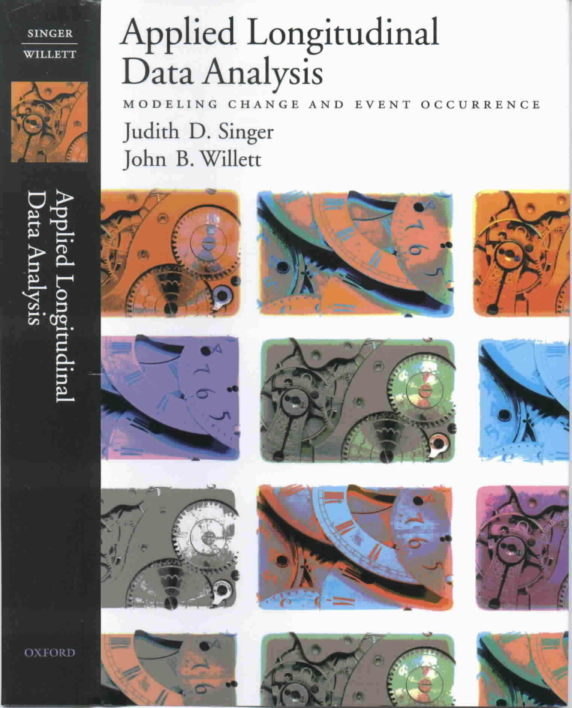

What is longitudinal Research?
The study of change
Methodological features
  Three or more waves of data
  An outcome whose value
  changes over time
  Sensible metric for time
Notes:
True - trajectory-based longitudinal research
Issues with two waves of data:
unable to describe the process of change
such as the SHAPE of that change
when did the change occur, how is it occurring – steady or delayed
less able to distinguish true change from measurement error
are the pretests too high? Posttests too low?
longer views are better able to distinguish this
An outcome whose value change over time
ideally this would be a continuous variable
Sensible metric for time
generally this is age, but it doesn’t have to be – touchon this later

Slide 5
Why study AGING longitudinally?
“Change is inevitable.
Change is constant”
– Benjamin Disraeli
Aging = Change
Ability to study change
  Within-individual change - how individuals change
  Inter-individual – differences in how individuals change

Slide 6
Types of Longitudinal Studies
Trend Study
  Different sample from a changing population
    Census
Panel Study
  Same sample followed up over a period of time
Cohort Study
  Same sample followed up over a period of time with a common characteristic, e.g. birthdate

Slide 7

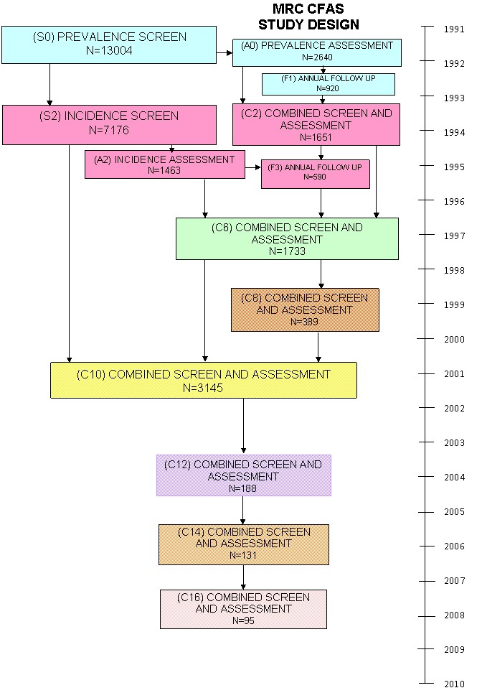
Longitudinal Studies
Notes:
MRC CFAS has six centres across England and Wales:
Cambridgeshire, Gwynedd, Newcastle, Nottingham, Oxford and Liverpool.
65 year and above were obtained from Family Health Service Authority lists from each centre.
The sample was stratified by age group (65-74 years and 75 years and over)
and equal numbers were randomly selected from each age group to produce an overall sample size of approximately
2500 people in each of the areas.

Slide 8
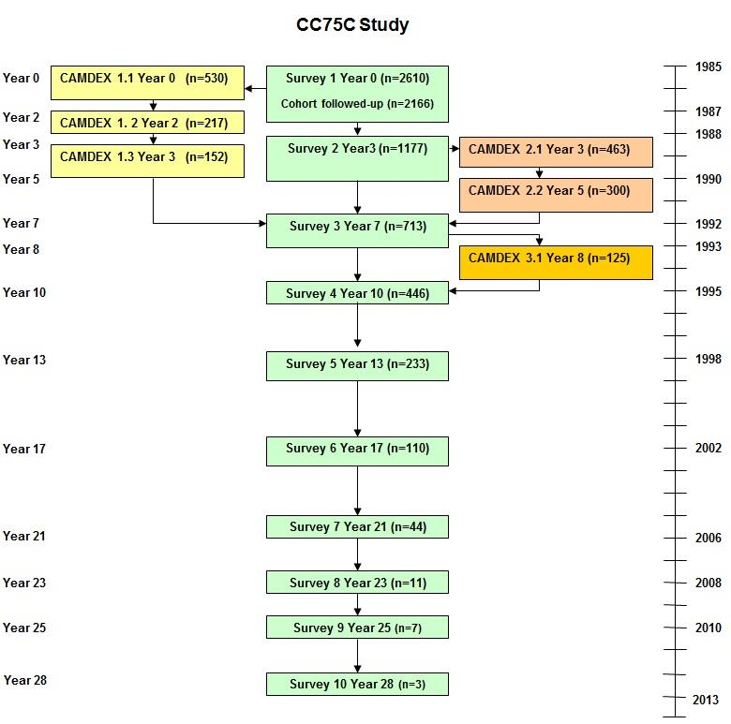
Longitudinal Studies
Cambridge City over-75 Cohort (CC75C)
Notes:
Started in 1985
≥75 at baseline

Slide 9


Longitudinal Studies
Telephone Interviews
Home Interviews &
Data Collection Site Visits
St. John’s
Victoria
Vancouver
Surrey
Calgary
Winnipeg
Montreal
Halifax
Ottawa
Sherbrooke
Hamilton
Notes:
The Canadian Longitudinal Study on Aging (CLSA) is a large, national, long-term study that will follow approximately
50,000 men and women who are between the ages of 45 and 85 when recruited, for at least 20 years.
Slide courtesy of the CLSA

Slide 10




Longitudinal Studies
Notes:
MRC National Survey of Health & Development (NSHD
5362 singleton births in mainland UK in March 1946
Nationally representative sample
Longest-running continually-studied birth cohort
is unique in having data from birth on the health and social circumstances of a representative sample (N=5362) of men and women born in England, Scotland or Wales in March 1946.
The foresight is amazing – in a pre-National Health Service era the study gathered the funds and kept it going
due in no small part by the leadership by Michael Wadsworth and Diana Kuh
Great study – 71 years of data with over 20 waves of data collection
fantastic retention – due in part by the active engagement of participants
- every year they receive a birthday card
The NSHD, the oldest of the British birth cohort studies,
1958 National Child Development Study; 1970 Birth Cohort Study, Next Steps (1989-1990); Millenium Cohort (2000-2001)

Slide 11
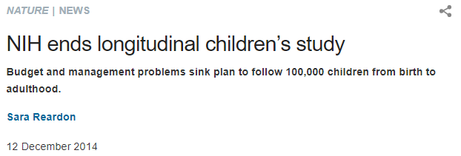



A note on Birth cohort Studies
Notes:
Great design with huge implications for longitudinal research
However, it becoming increasingly difficult to recruit and maintain
US tried to recruit 100,000 babies for National Children's Study (NCS), commissioned by the US Congress in 2000, was to assess how physical, chemical, biological and psychosocial factors affected 100,000 children from birth to age 21.
enrolled roughly 5,700 children in a pilot study at 40 centres around the United States.
The NIH has spent US$1.2 billion on the effort and
The UK tried to start a new Birth cohort study – the Life Study – same outcome
Economic and Social Research Council (ESRC) and the Medical Research Council, agreed to support the study with £38.4 million (US$58.9 million) until 2019
Not sure why, but in the post-war era was much different to now
- participants were very much discouraged from dropping out

Slide 12
Healthy (OR Successful) Aging
Articles published per year
Year
Notes:
Hueg increase in the number of articles published on healthy ageing.
Very mich a hot button topic, but what exactly is it? A
key component to longitudinal studies is having a consistent operational definition across each wave.
If you want to track something you need to measure it consistently.
Operationalisation is key

Slide 13

Healthy (OR Successful) Aging
Notes:
Hueg increase in the number of articles published on healthy ageing.
Very mich a hot button topic, but what exactly is it? A
key component to longitudinal studies is having a consistent operational definition across each wave.
If you want to track something you need to measure it consistently.
Operationalisation is key

Slide 14
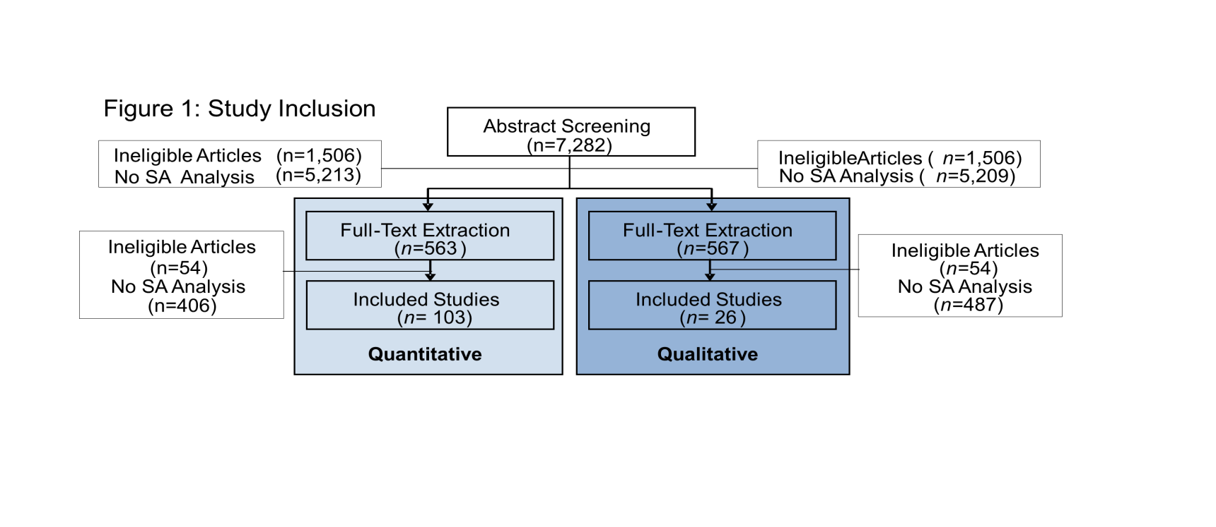
Healthy (OR Successful) Aging
Cosco, T.D., Stephan, B., Brayne, C. & The CC75C (2014) Operational definitions of successful aging: A systematic review. International Psychogeriatrics, 26(3).
Cosco, T.D., Stephan, B., Brayne, C. & The CC75C (2014) Lay perspectives of successful ageing: A systematic review and meta-ethnography. BMJ Open, 3(6).
  Researchers
  Older Adults
Cosco, T.D., Stephan, B., Brayne, C. & The CC75C (2014) Whose “successful ageing”? Lay- and researcher-driven conceptualisations of aeging well. European Journal of Psychiatry, 28(2).

Slide 15
Conceptualization

Slide 16
Conceptualization

Slide 17
Conceptualization

Slide 18
Longitudinal Analysis

Slide 19
Longitudinal Analysis

Slide 20
Modelling

Slide 21
Modelling
Cosco, T.D., Stephan, B., Brayne, C. & The CC75C (2014) (Unsuccessful) binary modelling of successful aging in the oldest old: A call for continuum-based measures. Journal of the American Geriatrics Society, 62(8).

Slide 22
Operationalization

Slide 23
Operationalization

Slide 24
MODELLING Issues
Range of functioning for “successful ageing”
Functioning
Time

Slide 25
MODELLING Issues
Successful aging trajectory
End-of-life trajectory
Range of functioning for “successful ageing”
Functioning
Time
Death
Cosco, T.D., Stephan, B., Brayne, C. (2013) Deathless models of aging and the importance of acknowledging the dying process. Canadian Medical Association Journal. 185(9): 751-752.

Slide 26
Modelling
  Index?
Example Survey Question | Responses | Value
How do you feel about the future? | Optimistic | 100
 | Empty expectations | 50
 | Pessimistic | 0
View of own health | Excellent | 100
 | Good | 67
 | Fair | 33
 | Poor | 0
Cosco, T.D., Stephan, B., Brayne, C. (2015) Validation of an a priori, index model of successful aging in a population-based cohort study: The Successful Aging Index. International Psychogeriatrics, 27(12): 1971-1979.

Slide 27
Modelling
100
80
60
Successful Ageing Index score
40
20
1
2
3
4
5
6
7
Data collection wave

Slide 28
Longitudinal Analysis
Notes:
Bear in mind the sample size
One of the disadvantages of longitudinal studies is attrition, either by death dropout etc.
Missing data is a fairly major issue s

Slide 29
Longitudinal Analysis

Slide 30
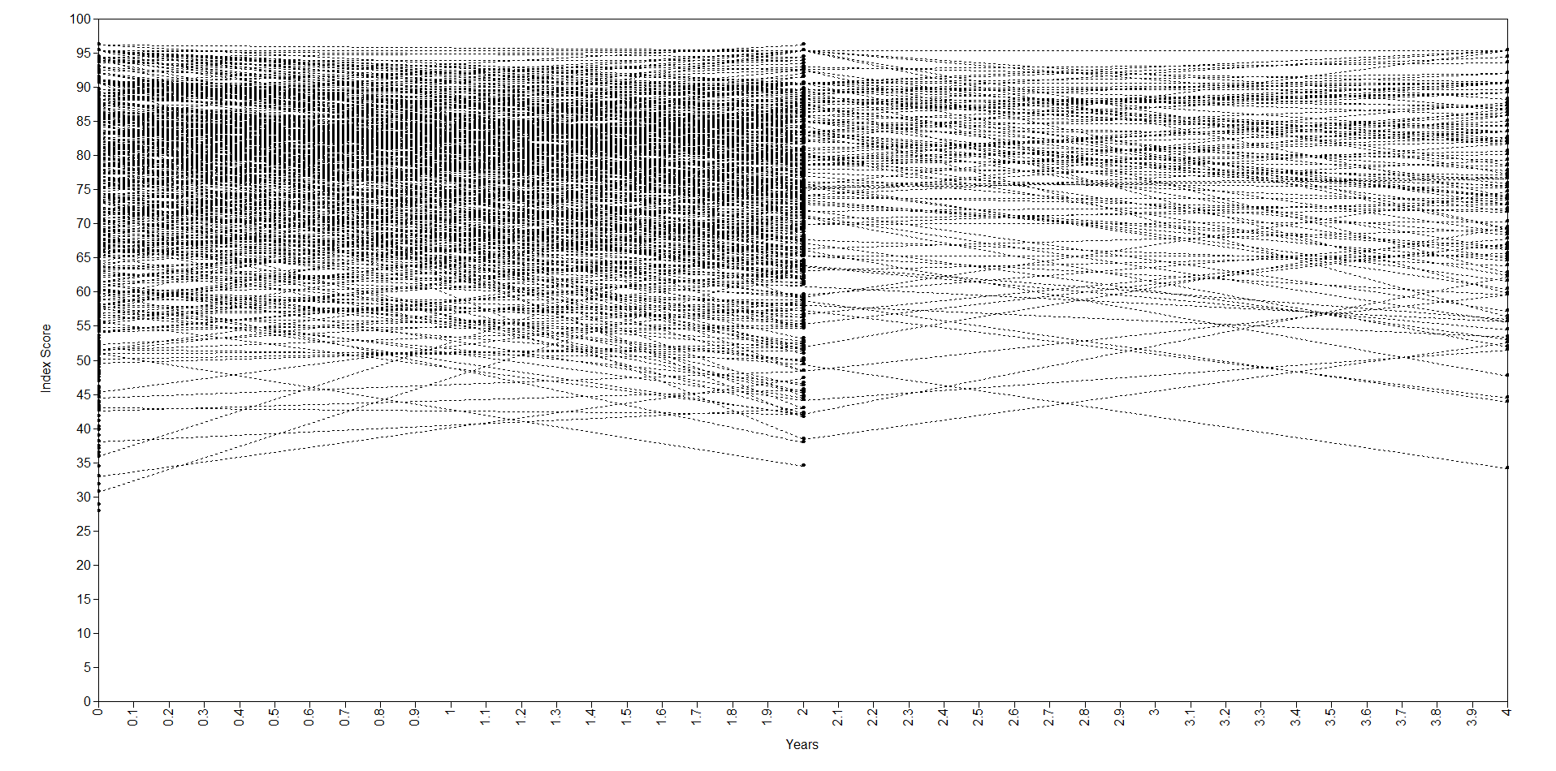
Longitudinal Analysis
Notes:
This is the result of plotting the index values over time
Spaghetti plot

Slide 31














Longitudinal Analysis
$$ε_{1}$$
$$ε_{2}$$
$$ε_{3}$$
$$ε_{t}$$
$$y_{1}$$
$$y_{2}$$
$$y_{3}$$
$$y_{t}$$
$$α$$
$$β$$
$${cov}_{1}$$
$${cov}_{2}$$
$$c$$
Notes:
Growth mixture modelling
$ε_{x}$= residual variance; $y_{x}$ = observed variable; $α$ = intercept ; $β$ = slope; $c$ = latent growth factor; cov = covariates;
Increasingly popular method due to its ability to identify homogenous subpopulations within a larger heterogeneous population, i.e. identifying longitudinal trajectories
Some issues with convergence when there are less than 10% of the original sample, hence only being able to use those 3 waves in CFAS

Slide 32
Longitudinal Analysis

Slide 33
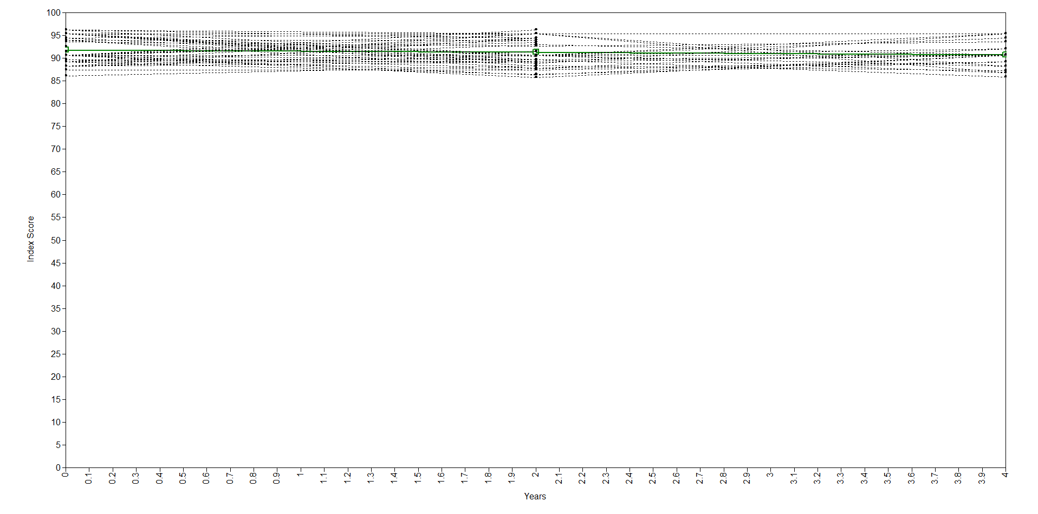
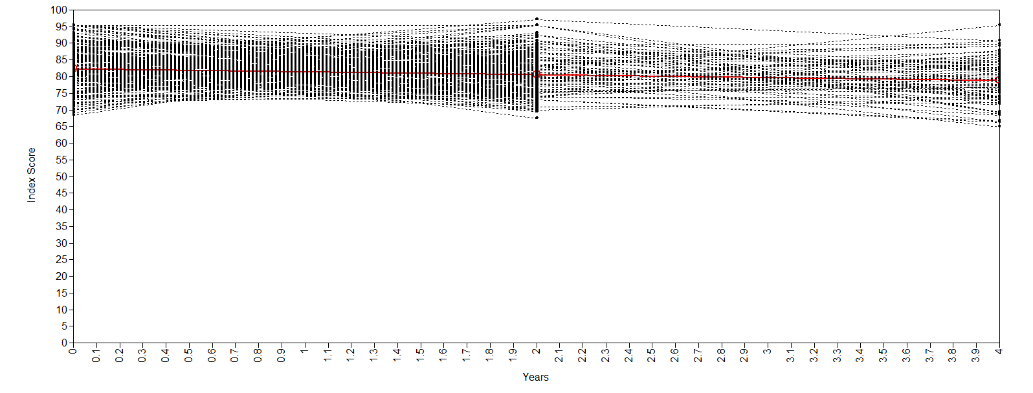
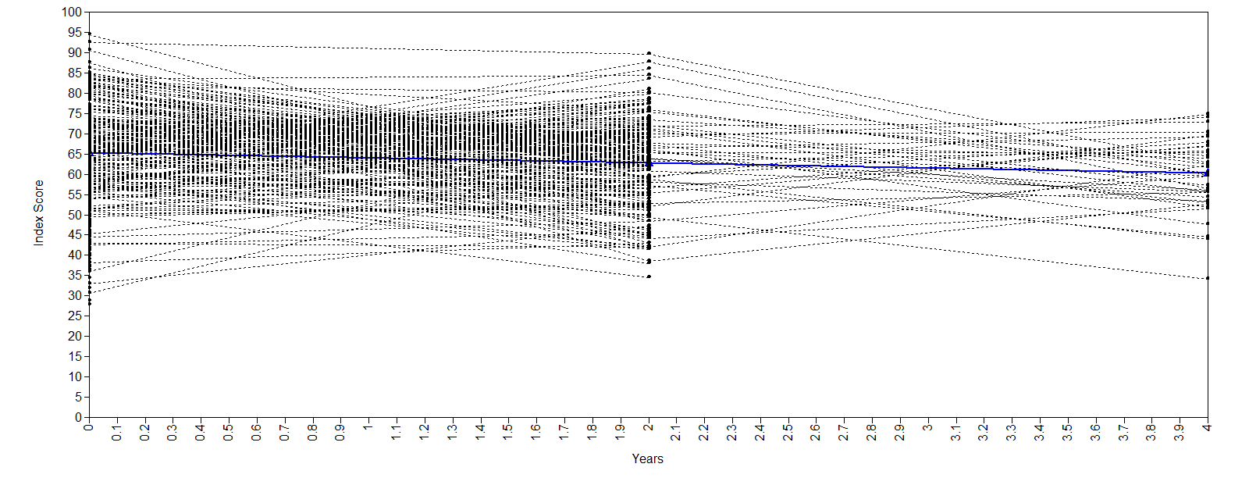
Growth Mixture Modelling
Notes:
Growth mixture

Slide 34
Trajectory Analysis
100
High Functioning Trajectory (HFT)
90
Moderate Functioning Trajectory (MFT)
80
Successful Ageing Index Score
Low Functioning Trajectory (LFT)
70
60
50
0
2
4
Years

Slide 35
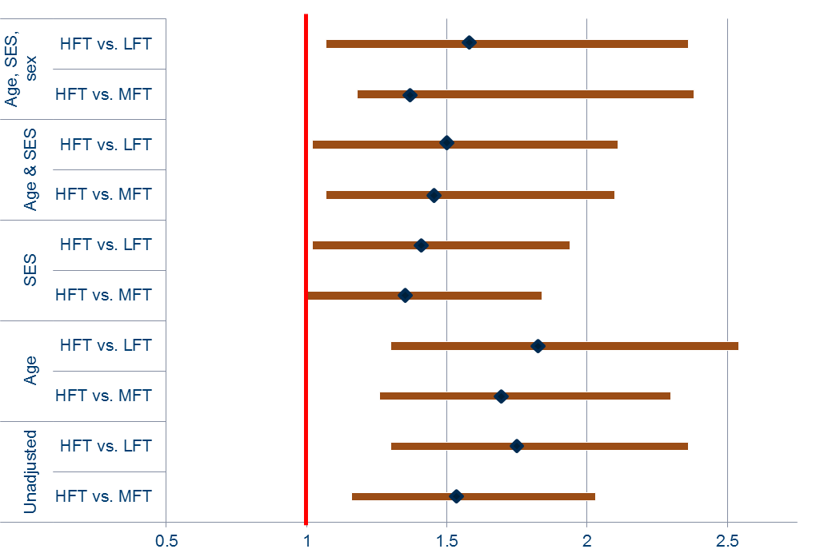
Trajectory Analysis
Education
(years):
0-9
10-11
>12
Odds Ratio

Slide 36
MODELLING Issues
Successful aging trajectory
End-of-life trajectory
Range of functioning for “successful ageing”
Functioning
Time
Death
Cosco, T.D., Stephan, B., Brayne, C. (2013) Deathless models of aging and the importance of acknowledging the dying process. Canadian Medical Association Journal. 185(9): 751-752.

Slide 37
Longitudinal Analysis
Last Wave Before Death (t1)
(n= 1015)
2nd Last Wave Before Death (t2)
(n= 361)
3rd Last Wave Before Death (t3)
(n= 171)
4th Last Wave Before Death (t4)
(n= 65)
Notes:
Some issues with convergence when there are less than 10% of the original sample,
Rather than looking at age as the time metric, look at time to death as the time metric
Longitudinal study requirements - reasonable metric for time – ticks the box

Slide 38
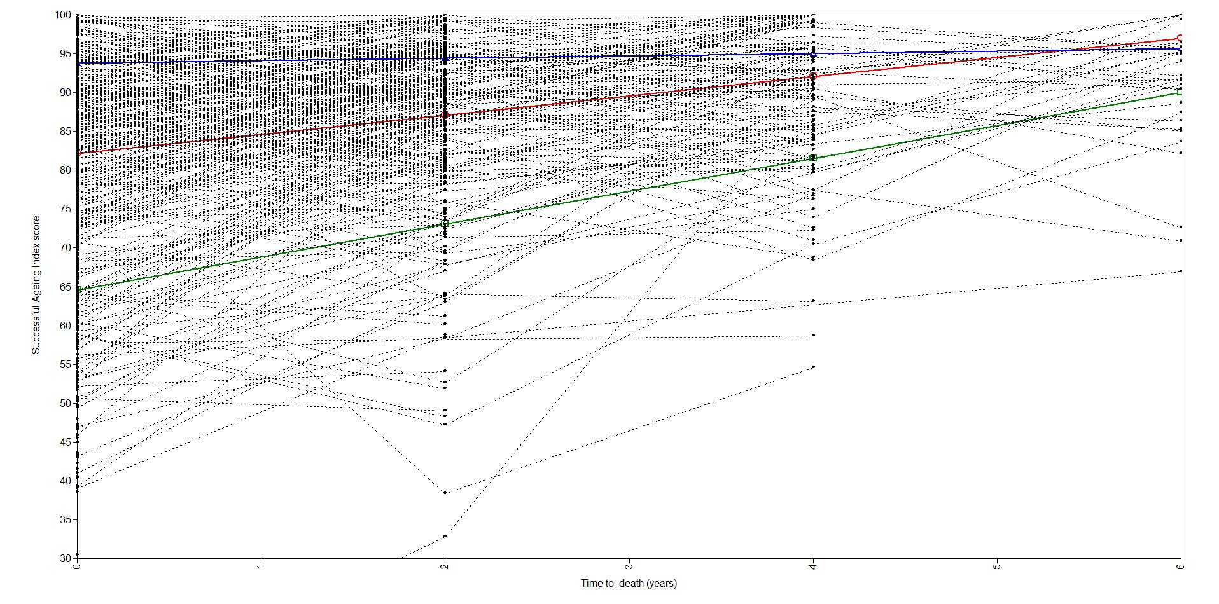
Longitudinal Analysis
Cosco, T.D., Muniz, G., Stephan, B.C., Brayne, C. (2016) A novel approach to the examination of successful aging trajectories at the end of life. Canadian Journal on Aging. 35(4): 533-540

Slide 39



Resilience
Positive Response
Adversity
Resilience
+
=
Cosco, T.D., Kaushal, A., Hardy, R., Richards, M., Kuh, D., Stafford, M. (2017) Operationalising resilience in longitudinal studies: A systematic review of methodological approaches. Journal of Epidemiology and Community Health. 77(1): 98-104
Notes:
Give examples:
Adversity: traumatic injury, psychological distress
Positive response: absence of psychological distress, high level of physical functioning
As before: operational definition is important
Did systematic review of operational definitions of resilience in longitudanl contexts

Slide 40
Resilience
Functioning
Legend
Adversity
Expected functioning given adversity experienced
Healthy ageing
Cosco, T.D., Howse, K., Brayne, C. (in press) Healthy ageing, resilience, and wellbeing. Epidemiology and Psychiatric Science.
Resilience

Slide 41
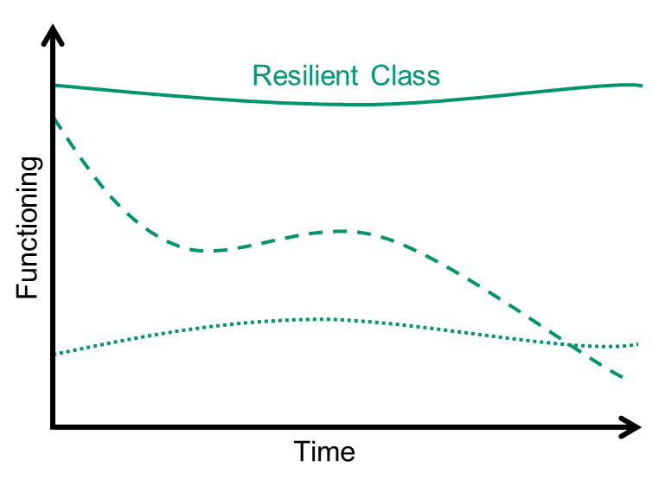
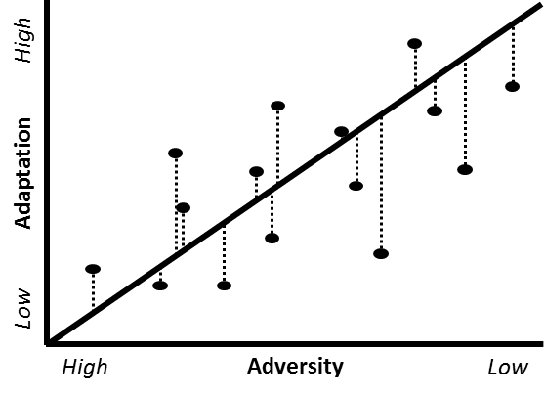
Operationalization
Definition-driven
 |  | Response
 |  | Lowest Tertile | Middle Tertile | Highest Tertile
Adversity | Highest Tertile | Maladaptive | X | Resilient
 | Middle Tertile | X | X | X
 | Lowest Tertile | Highly Vulnerable | X | Competent
Data-driven
Notes:
THIS SLIDE DOESN’T INCLUDE MASTEN’S TERTILES OR SIMILAR
Growth mixture modelling –
Individuals with an inherent adversity, e.g. sample of individuals with functional limitations,
examine best functioning in an adversity

Slide 42
Alternative Analyses
Adversity
Outcome
Mediators
Time

Slide 43
Alternative Analyses
Early Childhood
Adversity
Mental Health
Individual
and
Social
Resources
Time

Slide 44
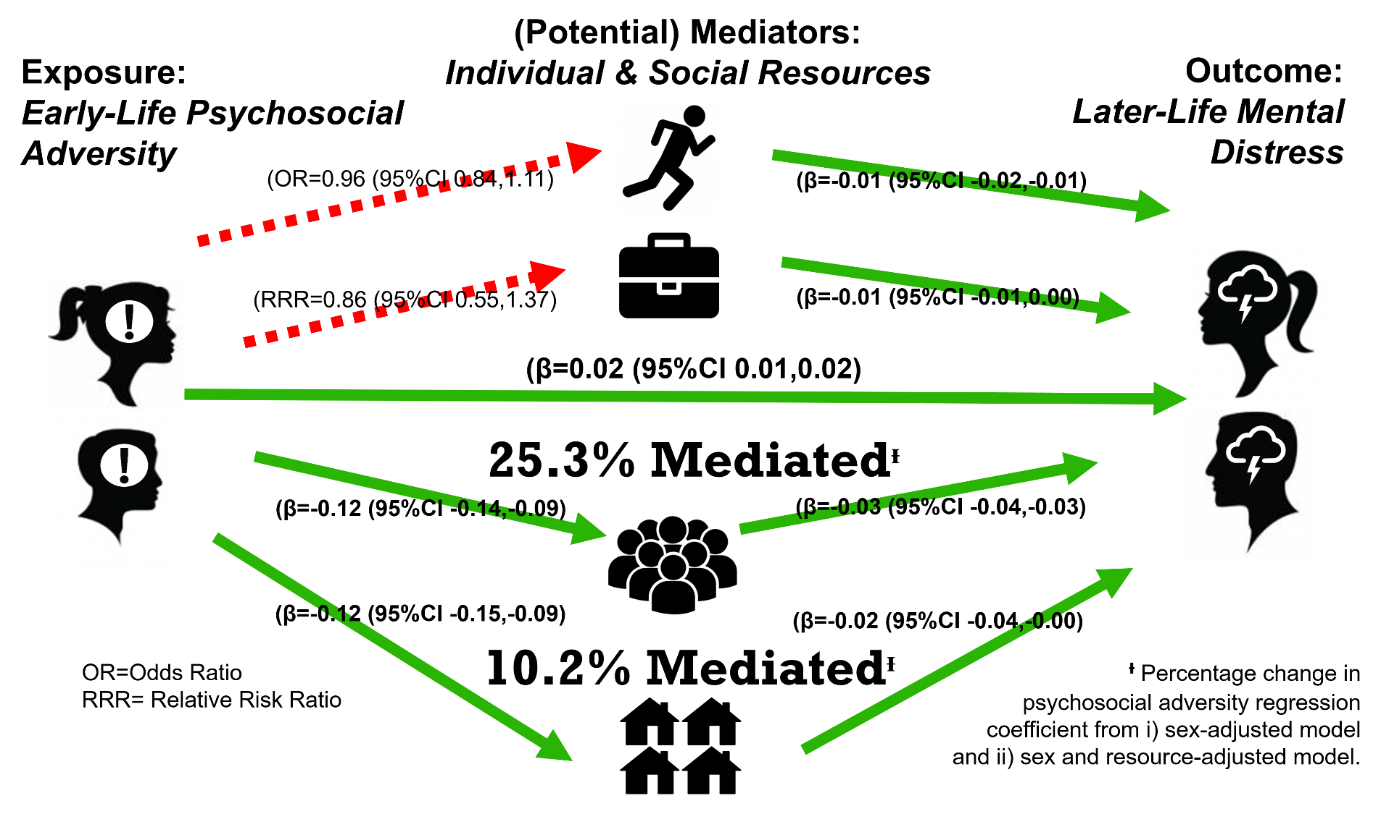
MEDIATION Analysis

Slide 45
SUmmary
Aging = Change
Longitudinal cohort studies follow the same people over time
  Variety of study characteristics:
    CFAS, CC75C, NSHD, CLSA
  Variety of methodological approaches: GMM, mediation
Healthy ageing and resilience
  Distinct but related constructs
Notes:
Aging is change, so you need a method of anlaysis that can accommodate and examine change

Slide 46
Future Directions
Longer studies = Richer data
More sophisticated data collection and analysis methods
Move away from traditional methods
More data scientists
Notes:
Longer studies = Richer data
More waves of data allows better plotting of trajectories provides more information
More sophisticated data collection and analysis methods
statistics packages are becoming much more user friendly
barrier to entry is lowering
much more accessible
Move away from traditional methods
clearly recruitment is an issues – as demonstrated by the failed National Children's Study in the US and Life Study in the UK
possibly due to commitment?
move away from paper and pen to digital technologies
More data scientists
there is a ton of data out there yet to be analyses
so in order to utilize these data we need more data scientists more than anything
shameless plug: so go out there and fill out a data access request for the CLSA!

Slide 47



Thanks
Acknowledgements
Study participants: CFAS, CC75C, NSHD, CLSA
Collaborators:
Cambridge: Carol Brayne, Blossom Stephan, Matthew Prina
London: Diana Kuh, Mai Stafford, Rachel Cooper, Marcus Richards
Oxford: Kenneth Howse
Contact
Theodore.Cosco@ageing.ox.ac.uk
TCosco@sfu.ca
https://www.researchgate.net/profile/Theodore_Cosco

Slide 48
REFERENCES
Bollen, K., & Curran, P. (2006). Latent curve models: A structural equation perspective. Hoboken, New Jersey: Wiley-Interscience.
Brayne, C. (2006). Incidence of dementia in England and Wales: The MRC cognitive function and ageing study. Alzheimer disease and associated disorders, 20 (SUPPL. 2), S47-S51.
Cosco, T. D., Brehme, D., Grigoruta, N., Kaufmann, L.-K., Lemsalu, L., Meex, R., . . . Brayne, C. (2015). Cross-cultural Perspectives of Successful Aging: Young Turks and Europeans. Educational Gerontology, 41(11), 800-813. doi:10.1080/03601277.2015.1050899
Cosco, T. D., Cooper, R., Kuh, D., & Stafford, M. (2017). Socioeconomic inequalities in resilience and vulnerability among older adults: a population-based birth cohort analysis. Int Psychogeriatr, 1-9. doi:10.1017/S1041610217002198
Cosco, T. D., Howse, K., & Brayne, C. (2017). Healthy ageing, resilience and wellbeing. Epidemiol Psychiatr Sci, 26(6), 579-583. doi:10.1017/S2045796017000324
Cosco, T. D., Kaushal, A., Hardy, R., Richards, M., Kuh, D., & Stafford, M. (2017). Operationalising resilience in longitudinal studies: a systematic review of methodological approaches. Journal of epidemiology and community health, 71(1), 98-104. doi:10.1136/jech-2015-206980
Cosco, T. D., Prina, A. M., Perales, J., Stephan, B., & Brayne, C. (2013). Lay perspectives of successful ageing: a systematic review and meta-ethnography. Bmj Open, 3(6), e002710. doi:10.1136/bmjopen-2013-002710
Cosco, T. D., Prina, A. M., Perales, J., Stephan, B., & Brayne, C. (2014a). Operational definitions of successful aging: A systematic review. International Psychogeriatrics, 26(3), 373-381. doi:10.1017/S1041610213002287
Cosco, T. D., Prina, A. M., Perales, J., Stephan, B., & Brayne, C. (2014b). Whose "successful ageing"? Lay- and researcher-driven conceptualisations of ageing well European Journal of Psychiatry, 28(2), 124-130.
Cosco, T. D., Stephan, B. C., & Brayne, C. (2013). Deathless models of aging and the importance of acknowledging the dying process. CMAJ : Canadian Medical Association journal = journal de l'Association medicale canadienne, 185(9), 751-752. doi:10.1503/cmaj.121720
Cosco, T. D., Stephan, B. C., & Brayne, C. (2014). (Unsuccessful) binary modeling of successful aging in the oldest-old adults: a call for continuum-based measures. Journal of the American Geriatrics Society, 62(8), 1597-1598. doi:10.1111/jgs.12958
Cosco, T. D., Stephan, B. C., & Brayne, C. (2015). Validation of an a priori, index model of successful aging in a population-based cohort study: the successful aging index. Int Psychogeriatr, 27(12), 1971-1977. doi:10.1017/S1041610215000708
Cosco, T. D., Stephan, B. C. M., Brayne, C., Muniz, G., & Mrc, C. (2017). Education and Successful Aging Trajectories: A Longitudinal Population-Based Latent Variable Modelling Analysis. Can J Aging, 36(4), 427-434. doi:10.1017/S0714980817000344
Cosco, T. D., Stephan, B. C. M., Muniz, G., & Brayne, C. (2016). A Novel Examination of Successful Aging Trajectories at the End of Life. Canadian Journal on Aging / La Revue canadienne du vieillissement, 1-8. doi:10.1017/S0714980816000519
Fleming, J., Zhao, E., O'Connor, D., Pollitt, P. A., & Brayne, C. (2007). Cohort profile: the Cambridge City over-75s Cohort (CC75C). International Journal of Epidemiology, 36(1), 40-46. doi:10.1093/ije/dyl293
Raina, P. S., Wolfson, C., Kirkland, S. A., Griffith, L. E., Oremus, M., Patterson, C., . . . Brazil, K. (2009). The Canadian longitudinal study on aging (CLSA). Canadian journal on aging = La revue canadienne du vieillissement, 28 (3), 221-229.
Singer, J., & Willett, J. (2003). Applied longitudinal data analysis. New York: Oxford University Press.
Wadsworth, M., Kuh, D., Richards, M., & Hardy, R. (2006). Cohort Profile: The 1946 National Birth Cohort (MRC National Survey of Health and Development). Int J Epidemiol, 35(1), 49-54. doi:10.1093/ije/dyi201

Slide 49
Longitudinal Studies
50,000 women and men aged 45 – 85 community dwelling at baseline
Tracking (20,000)
Randomly selected
10 provinces
Comprehensive (30,000)
Randomly selected
25-50 km of 11 sites in 7 provinces
Questionnaire
By telephone (CATI)
Questionnaire
In person, in home (CAPI)
Physical Assessments
Blood, Urine
At Data Collection Site
20 year study: Full follow up every 3 years, maintaining contact in between
Data Linkage
Notes:
The Canadian Longitudinal Study on Aging (CLSA) is a large, national, long-term study that will follow approximately
50,000 men and women who are between the ages of 45 and 85 when recruited, for at least 20 years.
Slide courtesy of the CLSA

Slide 50


Operationalization
+
=

Slide 51
Analysis
Occupational Status
Unskilled
Partly Unskilled
Skilled (manual)
Skilled (Non-manual)
Intermediate
Professional
Occupational Status
Unskilled
Partly Unskilled
Skilled (manual)
Skilled (Non-manual)
Intermediate
Professional
Education
Sub GCSE
O-Level
A-Level
Degree or above
Education
Primary only
Primary (no qualifications)
Secondary only
Secondary and higher
β
Sex-adjusted linear regression

